Slide 1
AML Project 3
By Dylan Miller, Jackson Dockery, and Luke Gegick

Slide 2
Problem Understanding
We are trying to find the best machine learning model for predicting the type of eclipses to take place given previous eclipse data
We aim to compare the supervised learning models
The solution to the problem will help to predict the best eclipses for viewing, and demonstrate the best model for interpreting complex prediction variables
Notes:
Speakers Notes: Our goal was to find the best model to predict the eclipse types in the NASA eclipse dataset. We are doing this through KNN, Linear Regression, Logistic Regression, SVM, and Gradient Boosting Trees. These models were all rigorously tested using dynamic parameter adjustments to see how they perform in predicting the 19 different eclipse types given a very limited dataset to support these eclipse types (ex. 6 was the lowest category meaning only 6 of one eclipse type to compare to the rest).

Slide 3
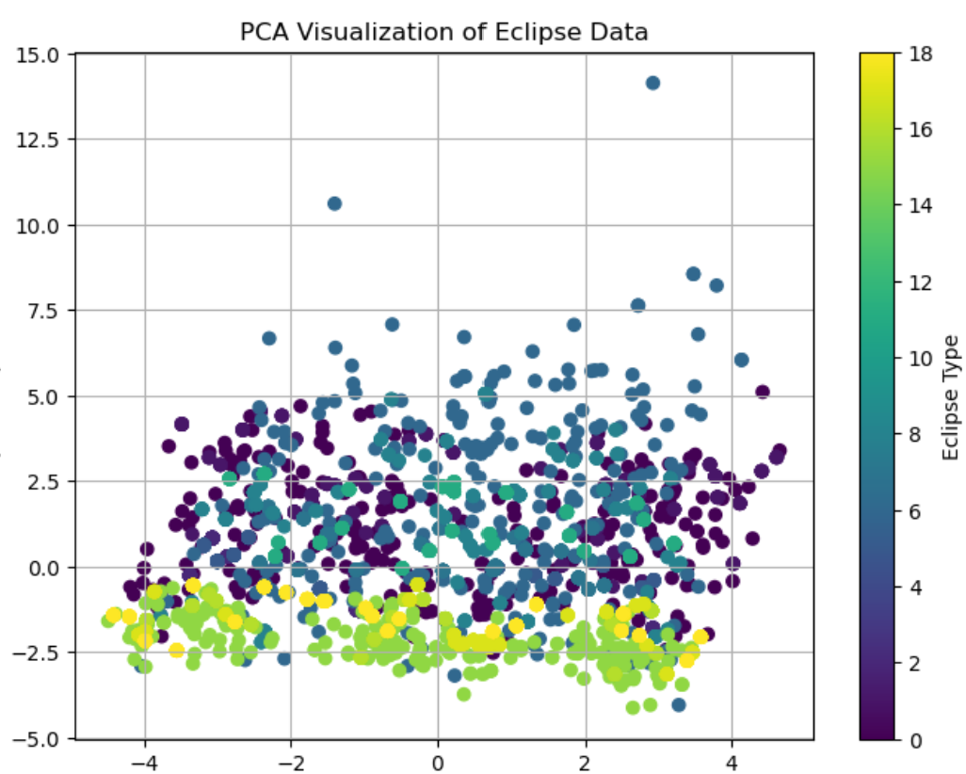
Data Understanding
Catalog Number, Calendar Date, Eclipse Time, Delta T (s),Lunation Number,Saros Number,Eclipse Type,Gamma,Eclipse Magnitude,Latitude,Longitude,Sun Altitude,Sun Azimuth,Path Width (km),Central Duration,Date Time,Year,Month,Day,Visibility,Eclipse Latitude,Eclipse Longitude,obliquity,Geographical Hemisphere,Daytime/Nighttime,Sun Constellation,Inter-Eclipse Duration,Visibility Score,Eclipse Classification,Duration in Seconds,Moon Distance (km),Sun Distance (km),Moon Angular Diameter (degrees),Sun Angular Diameter (degrees),Central Duration Seconds,Normalized Duration,Normalized Path Width,EII,Year Modulus,HEAS,Decade,Localized ESC,ESC Moving Average,ESC Wide-Scale Moving Average,Eclipse Interval,Cluster,Cluster 6
Delta T(s): The discrepancy in seconds between Terrestrial Time (TT) and Universal Time (UT)
Lunation Number: An enumeration system for identifying lunar months
Saros Number: Identifies the eclipse cycle, a period of approximately 18 years
Eclipse Type: Fraction of the Sun's diameter obscured by the Moon at the maximum point of the eclipse
Gamma: Measures how centrally the moon's shadow passes across Earth
Eclipse Magnitude: Fraction of the Sun's diameter obscured by the Moon at the maximum point of the eclipse
Sun Azimuth: The suns angular position along the horizon
Eclipse Latitude: the angular distance of the Moon from the Earth's equatorial plane
Eclipse Longitude: the longitudinal position of the Moon at the time of the eclipse
Obliquity: the tilt of the Earth's axis relative to its orbital plane around the Sun
HEAS: the Heliocentric Earth Angular Size data
EII: This index is a measure used to quantify the quality and significance of information
Notes:
The features in the dataset are in the ReadMe file with explanations as to what they are and if we included them.
The PCA shows the grouping among the predicted variables given the highest variation variables. The grouping shows that the variables we chose have a correlation between one another

Slide 4
Feature engineering
Catalog Number, Calendar Date, Eclipse Time, Delta T (s),Lunation Number,Saros Number,Eclipse Type,Gamma,Eclipse Magnitude,Latitude,Longitude,Sun Altitude,Sun Azimuth,Path Width (km),Central Duration,Date Time,Year,Month,Day,Visibility,Eclipse Latitude,Eclipse Longitude,obliquity,Geographical Hemisphere,Daytime/Nighttime,Sun Constellation,Inter-Eclipse Duration,Visibility Score,Eclipse Classification,Duration in Seconds,Moon Distance (km),Sun Distance (km),Moon Angular Diameter (degrees),Sun Angular Diameter (degrees),Central Duration Seconds,Normalized Duration,Normalized Path Width,EII,Year Modulus,HEAS,Decade,Localized ESC,ESC Moving Average,ESC Wide-Scale Moving Average,Eclipse Interval,Cluster,Cluster 6
Non-bold are dropped
Non-bold are less or not relevant to predicting the eclipse type
Notes:
Mention:
Justification of chosen features based on relevance and importance.
b. Explanation of feature selection methods.
c. Justification of chosen features based on relevance and importance.
d. Creation of new features or transformations that enhance model performanc

Slide 5
Model Selection and Training
We tried kNN, Linear Regression, Logistic Regression, SVM, and Gradient Boosted Trees
The models with the highest accuracy before mapping were logistic regression and SVM.
The model with the highest accuracy after mapping was kNN (85%) with SVM (70%) in close second.
Notes:
a. Exploration of multiple machine learning algorithms.
b. Proper splitting of data into training, validation, and testing sets.
c. Implementation of appropriate evaluation metrics

Slide 6
Hyperparameter Tuning
In our best models, KNN, and SVM, the parameters adjusted are the following:
KNN
n_neighbors, distance metric formula, and Metric weights
SVM
svm_C, svm_kernel, svm_probability, and svm_class_weight
We Tested these parameters dynamically using a param grid in tandem with a GridSearchCV to dynamically choose parameters.
Notes:
KNN : n_neighbors is the number of neighbors the KNN model predicts using in the KNN tests, in our case we predicted over a range of K values from 3 to 20
The KNN distance metric is the mathematical distance formula we chose, in our case, we tested for Manhattan, Chebyshev, and minkowski distance.
In KNN, the metric weights we tested were either uniform or distance metric weights.
SVM : svm_C is the regularization parameter used to control the margin of the hyperplane. Kernel is the type of hyperplane used, in our case it is linear as we wanted a linear hyperplane. Probability is a parameter we use to ensure better probability estimates, and class weight is used to assign a weight to different attributes in the data set

Slide 7
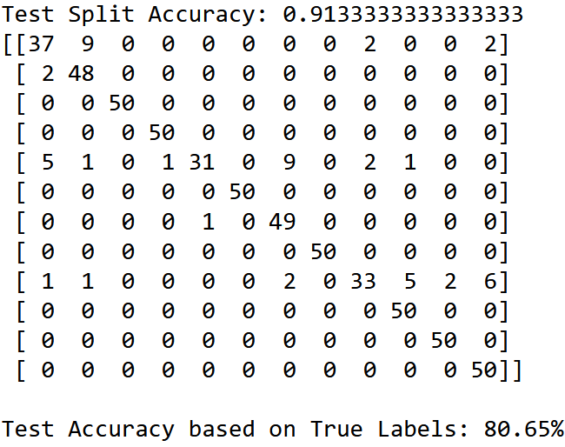
Results and Analysis
Based on the confusion matrix among other data we know
The Selected attributes of the data are the best for predicting eclipse types
There is minimal overfitting/ underfitting in our training model
The PCA shows the grouping of the data when transformed to two groups
Notes:
The photo is of the results from the KNN mapped version
a. Presentation of model performance metrics (e.g., confusion matrix, …).
b. Interpretation of model predictions and insights.
c. Visualization of key findings and analysis of results

Slide 8
CODE REVIEW

